Slide 1
1. Introduction. The Mobile Telephone System [3. pg. 530]
2. Cellular Wireless Network Evolution [2. pg. 152; 3. pg. 531]
3. Development of different generations of mobile systems [2. pg. 152; 3. pg. 533]
4. Wireless Services [2. pg. 157, 166]
5. Mobile Cellular Phone System [2. pg. 155]
6. Cellular Phone Concepts [3. pg. 506, 529, 533]
7. Routing for Mobile Hosts [2. pg. 372, 157; 3. pg. 538]
8. Handoff [2. pg. 159; 3. pg. 553]
9. Cellular Channel Concepts [2. pg. 162; 3.pg. 509;]
10. FDD & TDD duplexing
11. Channel Categories
12. Call Management [3. pg.551, 534, 372]
13. 2G; Phones: Digital Voice [2. pg. 152]
14. D-AMPS Data channel with three & six users. [2.pg. 159]
15. 2G; GSM Phones [2. pg. 159]
16. CDMA: IS-95; (QUALCOMM) [3.pg. 509, 816; 5. pg. 255]
3RD AND 4TH GENERATIONS OF MOBILE PHONES [ 3. pg.534]
17. 3G Cellular Phone Systems [3. pg. 534]
18. Cellular Evolution
19. 5th Generation Mobile Networks Alliance
20. APPENDIX
L.5. Concepts of Cellular
Communications [1] 10/11

Slide 2
1. Introduction. The Mobile Telephone System,
Three main multiplexing schemes:
FDMA, TDMA, and CDMA.
TDMA– IS-54; IS-136 -North American Standard
D-AMPS -Digital Advance Mobile Phone Systems
CDMA- CDMA – Code Division Multiple Access
cdma2000, W-CDMA/UMTS
FDMA- GSM - Pan-European Digital Cellular
(Group Special Mobile); (Global System for Mobile)
PDC - Personal Digital Cellular, Japanese
Iridium-Mobile Communication Satellite
UMTS- Universal Mobile Transport Service

Slide 3
To distinguish signals from several different transmitters FDMA and CDMA were developed.
With FDMA, the transmitting and receiving frequencies used in each cell and are different from the frequencies used in each neighboring cell.
The principle of CDMA achieves the same result. The distributed transceivers can select it in one cell and listen to it in other sells.
Time TDMA is used in combination with either FDMA or CDMA.

Slide 4
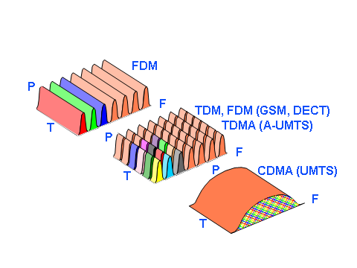

Slide 5
2. Cellular Wireless Network Evolution
First Generation: Analog Voice (1946)
  AMPS: Advance Mobile Phone Systems (1982)
  Residential cordless phone
  Second Generation: Digital Voice (1990)
  IS-54; IS-136: North American Standard - TDMA (1996)
  IS-95: CDMA (Qualcomm) (1993)
  GSM: Pan-European Digital Cellular (1991)
  Iridium , 2002: Mobile Communication Satellite (1998)
  Third Generation: Digital Voice and Data (2000)
  IMT-2000 (cdma2000, W-CDMA/UMTS- Combines
  the functions of: Cellular, Cordless, Wireless LANs, Paging, Bluetooth, etc. Supports multimedia services: Data, Voice, Video, Image.
  Fourth Generation (2010) - Internet based

Slide 6
Mobile generations typically refer to non–backward-compatible
Based on the observations, some sources suggest that a new generation of 5G standards may be introduced in the early 2020s.
New mobile generations are typically assigned new frequency bands (approximately 5.72-5.85 GHz) and wider spectral bandwidth per frequency channel (1G up to 30 kHz, 2G up to 200 kHz, 3G up to 5 MHz, and 4G up to 20 MHz).
The higher frequencies would overlap with transmission’s band of communication satellites.
If 5G reflects these prognoses, major difference between 4G and 5G must be something other than faster speed (increased peak bit rate). For example: Higher number of simultaneously connected devices,
lower battery consumption, better coverage, high bit rates, lower latencies, higher number of supported devices, lower infrastructure exploitation costs.

Slide 7
FDMA
AMPS
NMT
3. Development of different generations of mobile systems
IS-136
D-AMPS TDMA
EDGE
TDMA
IMT-SC
IS-136HS
UWC-136
GSM
PDC
GPRS
IMT-DS
UTRA FDD/W-CDMA
IMT-TC
UTRA TDD/TD-CDMA
IMT-TC
TD-SCDMA
IMT-MC
cdma2000 1XEV-DO
1XEV-DV
CDMA
IS-95
cdmaOne
Cdma2000 1x
GSM – 70% (Europe)
AMPS – 3%
PDC – 5% (Japanese)
CDMA – 12%
TDMA – 10%
1G 2G 2.5G 3G

Slide 8
Cellular phones
Satellites
Crdl.phone
Wireless LAN
1980
CTO
1981
NMT 450
1982
InmarsatA
1983
AMPS
1984
CT1
199x
proprietary
1986
NMT 900
1991
CDMA
1991
D AMPS
1988
InmarsatC
1987
CTO
1989
CT2
1997
IEEE 802.11
1992
GSM
1992
InmarsatM
1993
PDC
1991
DECT
1998
Iridium
1994
DCS 1800
1999
IEEE 802.11b,
802.15 Bluetooth
2000
GPRS
2001
IMT d-2000
2000
IEEE 802.11a
2010 Fourth Generation (Internet based)
analog
digital

Slide 9
4. Wireless Services
.
.
Cordless
Bluetooth
ZigBee
WiFi
Cellular
CDMA
P-to-P 802-16
0.7
1.9
1.7
UMTS; GSM
0.4
1
2
3
4
5
6
GHz
0.80-
0.90
0.90-
0.93
1.85-
1.99
2.39-
2.483
5.72-
5.85
10-66 GHz
0.85-1.90
2.15-2.20

Slide 10
Digital Cellular Systems World-wide
GSM
D-AMPS
Japan Digital
PCS 1900
DCS 1800
CDMA
PCS 1900 (Personal Communication Syst) based on GSM and DCS 1800 (Digital C.S.)

Slide 11
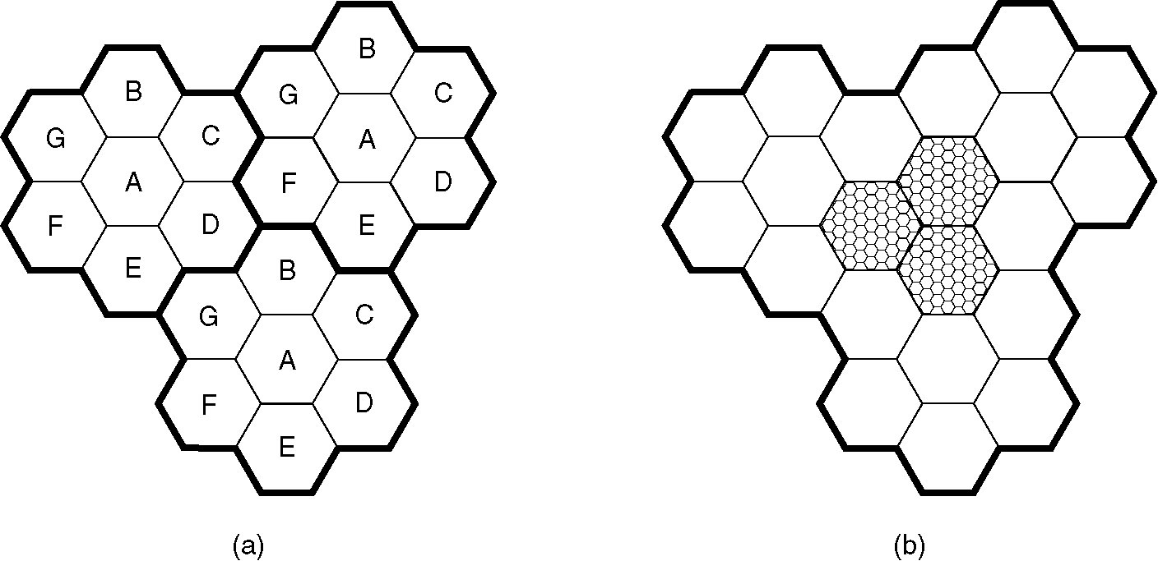
5. Mobile Cellular Phone System
Geographical separation
100 cells
10-20 km
Each of these cells is assigned multiple frequencies, which have corresponding radio base stations.
Frequencies are not reused in a group of 7 adjacent cells
To add more users, smaller cells can be used.
In each cell are duplex: uplink –”U” and downlink “D”)

Slide 12
6. Cellular Phone Concepts
Geographical separation
Capacity (freq.) reuse
Backbone connectivity
Hand-held telephone 0.6 watts; Car transmitters are 3 watts, (FCC restrictions).
Backbone connectivity
The base station consists of a computers and transmitter/receiver connected to an antenna.
BS
BS
BS
Publ. Swit. Tel. Net.
MTSO (Mobile Telephone Switching office)- MSC (Mobile Switching Center).
BS
BS
BS

Slide 13
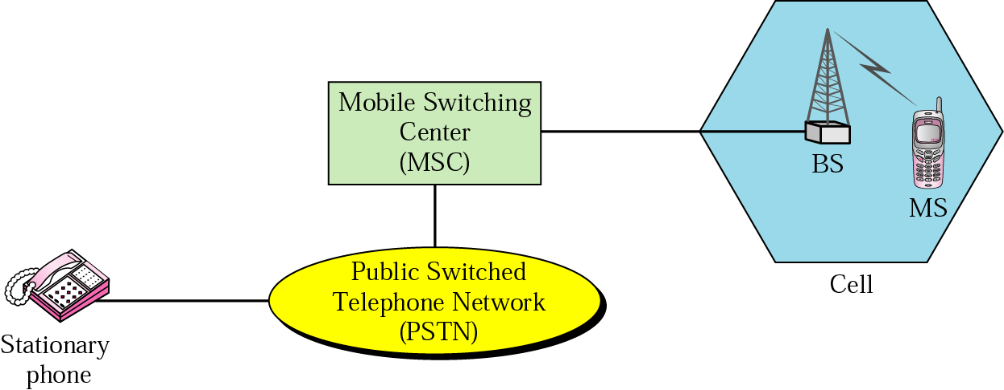
6a. Cellular Phone Concepts (cont)
MSO, the nerve center of the system
Backbone connectivity
If MS leaves a cell, it’s BS asks the surrounding BS’s how much power they are getting from it. The BS then transfers ownership to the cell getting the strongest power (Handoff)

Slide 14
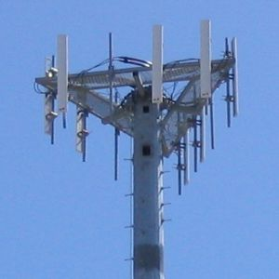
The frequency reuse factor is 1/K where K is the number of cells which cannot use the same frequencies for transmission.
Frequency reuse factors are 1/3, 1/4, 1/7, 1/9 and 1/12 (or 3, 4, 7, 9 and 12 depending on notation).
N sector antennas on the base station site can serve N different sectors. N is typically 3. A reuse pattern of N/K. Current reuse patterns are 3/7 (North American AMPS), 6/4 (Motorola NAMPS), and 3/4 (GSM).
If the total available bandwidth is B, each cell can only use a number of frequency channels corresponding to a bandwidth of B/K, and each sector can use a bandwidth of B/NK.

Slide 15
7. Routing for Mobile Hosts
Mobil host
Wireless cell
Home agent
Migrate host
Roaming
Home LAN
WAN
Foreign
Agent (FA)
MAN
Stationary hosts (SH); Migratory hosts (MH); Roaming host (RH)
Foreign agent (FA) keep track of all MH visiting the area

Slide 16
7a. MH registration procedure
Periodically, each FA broadcasts a packet announcing its existence and address. A newly-arrived MH may:
1) Wait for these messages, or
2) MH can broadcast a packet: “Are there any FA around”?
3) The MH registers with the FA its home address, current
DLL address, and some security information.
4) The FA contacts the MH’s HA and says: One of your hosts
is over here. The message from the FA to the HA contains
the FA’s network address. It also includes the security information to inform the HA that the MH is there.
5) The home agent examines the security information, to prove that it was generated within the past few seconds. If it is happy, it tells the FA to proceed.
6) When the FA gets the ACK from the HA, it makes an entry in its tables and informs the MH that it is now registered.

Slide 17
8. Handoff
Handoff: Transfer of a MS from one cell to another (0.3 sec.)
(Each BS constantly monitors the received power from each MS).
When power drops below threshold, BS asks neighbor BS
(with stronger received power) to pick up the MS, on a new channel, the old is not reused in adjacent cells) - handoff.
Hard handoff: User must switch from one frequency to another. The old BS drops the MS before the new one acquires it. If the new one is unable to acquire it, the cell is disconnected abruptly.
Soft Handoff: The MS is acquired by the new BS before the previous one drops (available only with CDMA), the MS needs to be able to tune to two frequencies at the same time
Neither first nor second generation devices can do this.

Slide 18

8a. Handoff (Cellular Concepts, cont)
Soft Handoff: simultaneous radio link between MS and different BSs
Hard handoff: The old BS drops the MS before the new one acquires it.

Slide 19
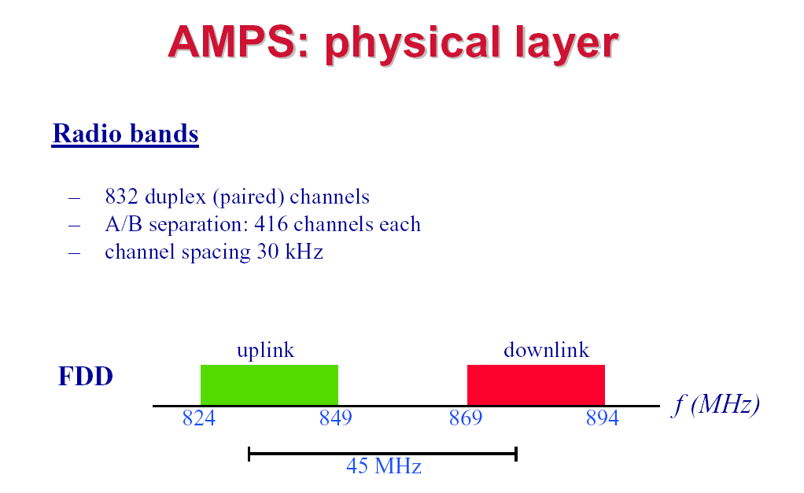
9. Cellular Channel Concepts
AMPS uses FDD to separate the channels.
Each simplex channels is 30 KHz wide. 832 x 30 =24960 KHz
(A) 832 channels (B) 832 channels
U
D
(Freq Division
Duplex)
25 MHz

Slide 20
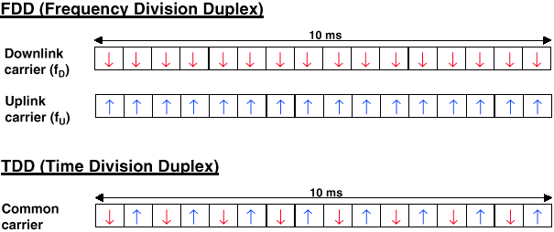
10. FDD & TDD duplexing

Slide 21
11. Channel Categories
AMPS
832 channels are divided into four categories:
1. Control (BS to MS) (=21) to manage the system (PSK) channels are reserved for control, and are wired into a Programmable Read-Only Memory (PROM)
2. Access (bidirectional) for call setup and channel assignment channels “U” and “D”.
3. Paging (BS to MS) to alert users to calls for them.
4. Data (bidirectional: “U” and “D”) for voice, fax, or data. (FM)

Slide 22
BS
Control
(PROM; 21)
Paging
(#)
Data
Access
(“U” ; “D”)
MS

Slide 23
12. Call Management
A. Each MS in AMPS has a 32-bit serial ID number and a 10-digit phone number in its PROM.
1. When phone is switched ON, it scans a PROM list of 21 control channels to find the most powerful signal.
2. PROM transmits its ID number to the (MSC) – which informs the home MSC (registration is done every 15 min).
B. To make a call, user transmits destination Ph # on access channel; MSC will assign an idle data channel (frequency)
1. At the same time MSC pages the destination cell for the other party (idle phone listens on all page channels).
2. All the control information, is sent in digital form, multiple times, and with an error-correcting code, even though the voice channels themselves are analog.

Slide 24
12b. Call Management
C. To accept Incoming calls, all idle phones continuously listen to the paging channel to detect messages directed to them. When a call is sent to a MS, a packet is sent to the caller’s home MTSO to find out where it is. A packet is then sent to the BS in its current cell, which then sends a broadcast on the paging channel of the form “Unit 14, are you there?” The called phone then responds with “Yes” on the access channel. The BS then says something like “Unit 14, call for you on”. Data channel “U” and “D”. At this point, the called phone switches to channel “U” and “D” and starts making ringing sound.

Slide 25
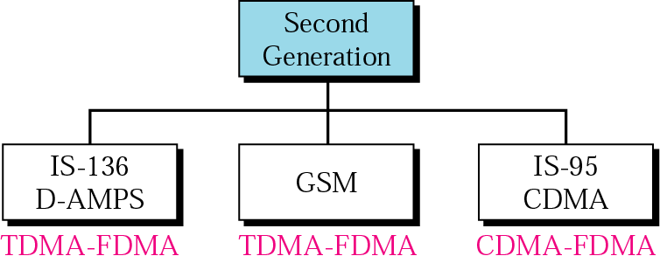
13. 2G; Phones: Digital Voice

Slide 26
13a. 2G; Phones: Digital Voice
Four systems are: D-AMPS, GSM, CDMA, and PDC (Personal
Digital Cellular, Japanese)
FDD: 1850-1910 MHz Upst.; 1930-1990 MHz Downst.
Waves are 16 cm long, ¼-wave antenna is 4 cm long.
D-AMPS can use both the 850 MHz and 1900 MHz bands to get a wider range of available channels.
The voice signal picked up by the microphone is
digitized and compressed.
The compression is done in the telephone.
3 users can share a single frequency pair
using TDM. Each frequency pair supports 25 frames/sec
of 40 msec each.
Each of 25 frames is divided into 6 time slots of 6.66 msec each, (6.66msec x 6=39.96 msec);
=25 frames/sec x 6 slots = 150 msec
Data Modulation: Pulse Code Modulation

Slide 27
FDMA
10.b D-AMPS, or IS-136, is a digital cellular phone system using TDMA and FDMA.
TDM
s₁(t)
S₁(f)
S₂(f)
S_{N}(f)

f₁
+
f₁
f₂
f_{N}
f
B_{user}
s_{N}(t)

f_{N}
Narrow single-user bandwidth

Slide 28
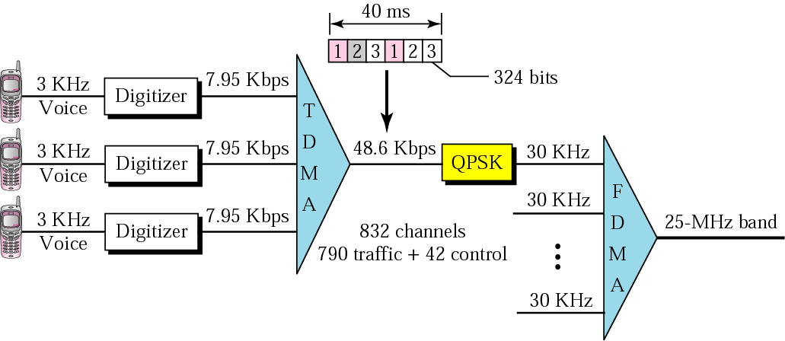
13b. D-AMPS

Slide 29
14. D-AMPS Data channel with three & six users.
TDM frame
40 msec
TDM frame
40 msec
1850.01 Mhz
MS-BS
1930.05 Mhz
BS-MS
Upstrm
Downst
1
2
3
1
2
3
1
2
3
4
5
6
1850.01 Mhz
MS-BS
1930.05 Mhz
BS-MS
users
3
1
2
3
1
2
6
1
2
3
4
5
1/3 of time a MS is idle = line quality measurement
1/6 of time a MS is idle = line quality measurement
324 bit slot=64 bits of control+101 bits of error correction+159 bits of speech data.
Speed=50 slots/sec
It uses idle slots to measure the line quality. As in D-AMPS, it still takes about 300 msec to do the handoff. =MAHO (Mobile Assisted Handoff).

Slide 30
D-AMPS; IS-54, IS-136
D-AMPS
Channel multiplexig | FDMA+6 TDM slots
Uplink (initially) (later) | 824-849 MHz; 832 channels (x 6=4992) 1850-1910 MHz
Downlink (initially) (later) | 869-894 MHz; 832 channels (x 6=4992) 1930-1990 MHz
Channel BW | 30 kHz
FDD separation | 45 MHz
Modulation | FM (traffic, voice); FSK (control) PCM
Channels | system configuration, real-time control, non real-time control, paging, short messages.
Channel Rate | 48.6 kbps
Voice compression | 56 kbps to 8 kbps; PCM
TDM frames | 25 frames, 40 msec each
Time slots | 6 slots, 6.67 msec each; (25x6=150 msec)

Slide 31
15. 2G; GSM Phones
(Group Special Mobile)
(Global System for Mobile)
GSM
Pan-European Cellular Standard: 2G; Digital
FDD: (890-915 MHz Upstr; 935-960 MHz Downstr.)
124 frequency carriers; 8 channels per carrier
Carrier spacing: 200 KHz (Narrowband TDM)
Modulation: PSK
FHSS modulation (217.6 hops/s) to overcome
multipath fading. (Dwell time=1/217.6=4595 μs)
First approximation, GSM is similar to
D-AMPS.

Slide 32
2G- GSM is similar to
2G- D-AMPS.
D-AMPS is used in the U.S. and in Japan (modified). Everywhere else in the world used GSM
GSM | D-AMPS
FDM | FDM
Dual simplex channels | Dual simplex channels
Single frequency pair is split by TDM | Single frequency pair is split by TDM
Channel 200 kHzwide | Channel 30 kHz wide
Higher data rate

Slide 33
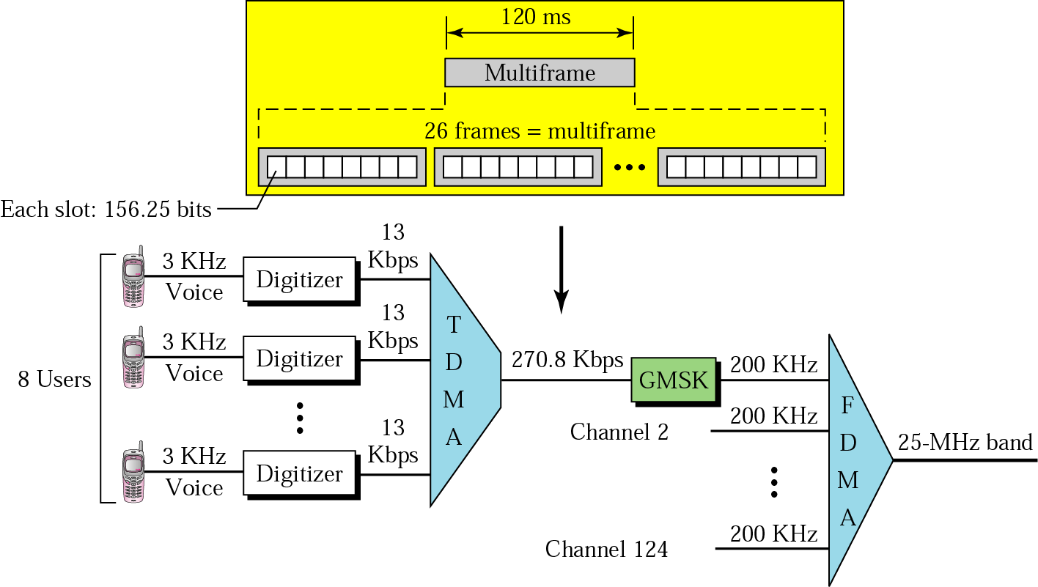
GSM (cont)
Gaussian minimum shift keying

Slide 34
GSM-The Global System for Mobile Communications
GSM
TDM frame
959.8 MHz
935.4 MHz
935.2 MHz
914.8 MHz
890.4 MHz
890.2 MHz
Simplex. Chann.
124
BS to
2 MS
1
124
MS To
2 BS
1
Frequency
Time
GSM uses 124 frequency channels, each of which uses an 8-Slot TDM system. (one TDM frame is absent). 992 Ch/cell (124 x 8).

Slide 35
GSM system (repetition)
A GSM system has 124 pairs of simplex channels;
Each 200 kHz wide.
Supports eight separate connections, using TDM
Each active station is assigned one time slot on one channel pair.
992 channels (124x8) can be supported in each cell, but many of them are not available, to avoid frequency conflict with neighboring cells.
Transmitting and receiving does not happen in the same time slot because the GSM radios cannot transmit and receive at the same time and it takes time to switch from one to the other.
GSM

Slide 36
GSM system (Calculations)
A data frame is transmitted in 547 μsec, Tx is only allowed to send one data frame every 4.615 msec, since it is sharing the channel with seven others.
Channel gross rate: 270,833 bps, divided among eight users. This gives 33.854 kbps gross, more than double D-AMPS, 324 bits 50 times per second for 16.2 kbps.
After error correction, 13 kbps is left for speech, giving better voice quality than D-AMPS (using correspondingly more bandwidth). Eight data frames make up a TDM frame and 26 TDM frames make up a 120-msec multiframe. Of the 26 TDM frames in a multiframe, slot 12 is used for control and slot 25 is reserved for future use, so only 24 are available for user traffic.
GSM

Slide 37
Control Channels (CC)
GSM
CC used to manage the system.
The broadcast control channel (BCC) is a continuous stream from the BS containing the BS’s identity. All MS monitor their signal strength.
The dedicated control channel (DCC) is used for location updating, registration, and call setup. In particular, each BS maintains a database of MS.
The common control channel (CCC), which is split up into three logical sub-channels:
The paging channel CC3a), which the BS uses to announce incoming calls. Each MS monitors it continuously to watch for call it should answer.
The random access channel (CC3b). This allows users to request a slot on the dedicated control channel. If two requests collide, they are garbled and have to be retried.
The access grant channel (CC3c). Announces assigned slot.

Slide 38
GSM;
Channel multiplexing | FDM+8 TDM slots
Uplink (GSM900) (DCS1800) | 890-915 MHz; 125 channels (x8=1000) 1710-1785 MHz
Downlink (900) (DCS1800) | 935-960 MHz; 125 channels (x8=1000) 1805-1880 MHz
Channel Bandwidth | 200 kHz
FDD separation | 45 (900) / 95 (1800) MHz
Modulation | FSK
Channels | Brdcst. Cont; Ded. Cont; Comn. Cont.= =Paging.+Rndm. Access+Acc. Grnt.
Channel Rate | 13 kbps
TDM frames | 24 frames, 120 msec each
Time slots | 8 slots, 0.577 msec each; (24x8=192)
CELL

Slide 39
16. CDMA: IS-95; (QUALCOMM)
CDMA
Based on DSSS
Two frequency bands (1.25 MHz), one for forward channel (cell-site to subscriber) and
one for reverse channel (subscriber to cell-site)
Sprint PCS = CDMA;
AT&T + Wireless = D-AMPS.
CDMA allows reuse of same spectrum over all cells. Network capacity improvement:
IS-95 is a digital cellular phone system using CDMA/DSSS.

Slide 40
a. CDMA (cont)
CDMA
CDMA is different from D-AMPS, and GSM.
Instead of FDM each with hundreds narrow channels (GSM; D-AMPS), CDMA each station transmits over the entire frequency spectrum all the time.
Multiple transmissions are separated by unique “code” for each user;=code set partitioning
All users share same frequency, but each user has own “chipping” sequence (i.e., code) to encode data
Chipping rate > data rate
Encoded signal = original data bit X chipping
sequence
Decoding= received encoded signal
X chipping sequence
allows multiple users to “coexist” and transmit

Slide 41
b. CDMA (cont)
CDMA
Each bit time is subdivided into m short intervals called chips. Typically: m=8, 64 or 128 chips / bit.
Each station is assigned a unique m-bit code called a chip sequence. For m=8, if station A is assigned the chip sequence 00011011, it sends a “1” bit by sending 00011011 and a “0” bit by sending complimentary 11100100.
Increasing the amount of information b bits/sec to mb chips/sec can only be done if the bandwidth available is increased by a factor of m,
With GSM; D-AMPS If we have a 1-MHz band available for 100 stations, with FDM each one would have 10 kHz and could send at 10 kbps (assuming 1 bit/Hz).
With CDMA, each station uses the full 1 MHz, so the chip rate is 1 M chip/sec. With fewer then 100 chips per bit, (calculation-100 x 8=800) the effective bandwidth per station is higher for CDMA than FDM.

Slide 42
1
0
t
t
t
t
8
b x 8
8

Slide 43

c. CDMA: two-sender interference
CDMA
2b x 8 =16

Slide 44
d. CDMA (cont’d)
CDMA
Each transmitting station has its own chip sequence. The receiver must know station’s chip sequence in advance.
Receiver listens all the senders at once by running the decoding algorithm for each of them in parallel.
In an ideal, noiseless CDMA system, the capacity (number of channels) can be made large. In practice, physical limitations reduce the capacity.
CDMA is typically used for wireless systems. The power levels received at the BS depend on how far away the transmitters are.
CDMA operates in a band of 1.25 MHz (versus 30 kHz for D-AMPS and 200 kHz for GSM), but it supports many more users in that band than either of other systems. In practice, the bandwidth available to each user is as GSM and often much better.

Slide 45
e. CDMA: cell breathing
CDMA
It is possible that Tx power used by some users is higher than that sufficient to be received by the unloaded cell, even though it is at a higher path loss.
Served area of the two cells varies as a function of the relative load, because in the unloaded cell also farther connections can be kept at low power.
Cell B
Cell A
CELL
Cell B
Cell A

Slide 46
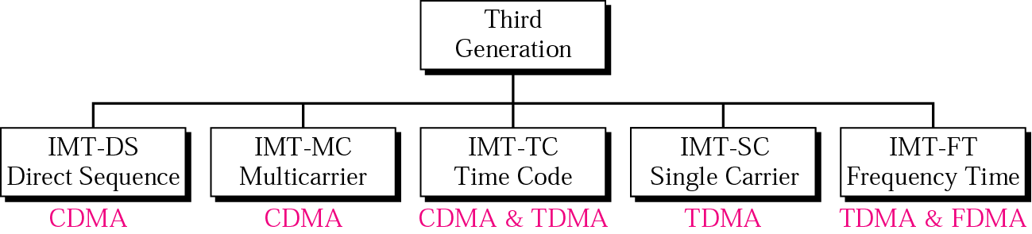
3RD AND 4TH GENERATIONS OF MOBILE PHONES
17. 3G Cellular Phone Systems
The main goal of third-generation cellular telephony is to provide universal personal communication.
IMT - International Mobile Telecommunications

Slide 47
18. Cellular Evolution
  Third Generation (3G) : W-CDMA
  Combines the functions of: cellular, cordless, wireless LANs, paging etc.
  Supports multimedia services (data, voice, video, image)
  Before full 3G deployment, a progression of integrated, high performance systems (2.5G):
  (a) GPRS (for GSM)
  (b) EDGE (for GSM)
  (c) 1xRTT (for CDMA)
  - the final system: UMTS, CDMA 2000, WCDMA
CELL

Slide 48
UMTS (Universal Mobile Transport Service)
CELL
Requirements
384 Kbps for full area coverage
2 Mbps for local area coverage
variable bit rate
packet traffic support
flexibility (eg, multiple, multimedia streams on a single connection)

Slide 49
Third-Generation Mobil Phones;
3G
3rd called IMT-2000; (1992)
1. The year into service;
2. Operate frequency (in MHz),
3. The bandwidth (in kHz).
Finally: 2Mbps has problems, due to the difficulty of performing handoff quickly.
More realistic is: 2 Mbps for stationary indoor users,
384 kbps for walking, and
144 kbps for connections in cars.
IMT-2000 network basic services:
1. High-quality voice transmission.
2. Messaging (replacing e-mail, fax, chat, etc.).
3. Multimedia (music, viewing videos, films, televisions).
4. Internet access (Web, pages with audio and video).
CELL

Slide 50
3G
CELL
Main proposals:
W-CDMA (Wideband CDMA), (Erickson), called UMTS (Universal Mobile Telecommunication System). !!!!!!!!!!!
This system uses DSSS; It runs in a 5 MHz bandwidth; Interworks with GSM networks, but not vise versa;
(It NOT loses cell when leave a W-CDMA cell and enter a GSM cell)
CDMA2000, (Qualcomm). It uses a DSSS design, basically an extension of IS-95; With backward compatible with IS-95; It also uses a 5-MHz bandwidth, NOT interworks with GSM; Cannot hand off calls to a GSM cell (or D-AMPS).
Other technical differences with W-CDMA:
different chip rate,
different frame time,
different spectrum used, and
different way to do time synchronization.

Slide 51
W-CDMA (Wideband CDMA)
3G
Key features proposed (Ericsson):
Improved capacity and coverage; Using DSSS; backward compatible.
It runs in a 5 MHz bandwidth and has been designed to interwork with GSM
It have the property that a cellular can leave a W-CDMA cell and enter a GSM cell without losing the call. This system called UMTS
High degree of service flexibility: multiple, parallel services per connection; efficient packet access
Operator flexibility: asynchronous inter station operation; hierarchical cell structures (HCS); adaptive antenna arrays;
CELL

Slide 52
CDMA2000: Features, benefits, and performance
CELL
Demand for new services and operators to provide benefits:
a. Increased Voice Capacity. The major source of traffic for wireless operators. CDMA 2000 delivers the highest voice capacity.
b. Higher Data Throughput. Today's commercial (phase 1) CDMA2000 networks support a peak data rate of 2.4 Mbps.
c. Frequency Band Flexibility. CDMA2000 networks have already been arranged in the 450, 800, 1700, and 1900 MHz bands.

Slide 53
4G is a successor to the 3G and 2G families of standards. In 2008, the ITU-R specified the IMT-Advanced (International Mobile Telecommunications) requirements for 4G standards, setting peak speed for 4G service at 100 Mb/s for high mobility communication (such as from trains and cars) and 1 Gbp/s for low mobility communication (stationary users).
LTE (Long-Term Evolution) for commonly marketed as 4G LTE, is for wireless communication of high-speed data for mobile phones. It is based on the GSM / EDGE and UMTS network technologies, the capacity and speed. First available LTE service was launched on December 14, 2009.
A 4G system provide a comprehensive and secure all-IP based mobile broadband solution to laptop computer wireless modems, smartphones, and other mobile devices. Facilities such IP telephony, gaming services, and streamed multimedia may be provided to users.

Slide 54
19. 5th Generation Mobile Networks Alliance
The defines the following requirements that a 5G standard should complete:
Data rates of tens of Mb/sec for tens of thousands of users
Data rates of 100 Mb/sec for metropolitan areas
1 Gb/sec simultaneously to many workers on the same office floor
Several hundreds of thousands of simultaneous connections for wireless sensors
Coverage improved
Signaling efficiency enhanced
Latency reduced significantly compared to LTE

Slide 55
wide-area "mobile" service
B
A=B=C=D=E=F=G
G
C
Small cells densely
"short" wireless links + fiber optic cable
Urban area
A
D
F
F/O link
E
m3
Device densities of up to 100 devices/m2
m1
m2
MSO
Wave bands (20 – 60 GHz)
data-access speeds of up to 10 Gbit/s

Slide 56


Slide 57
20. APPENDIX

Slide 58
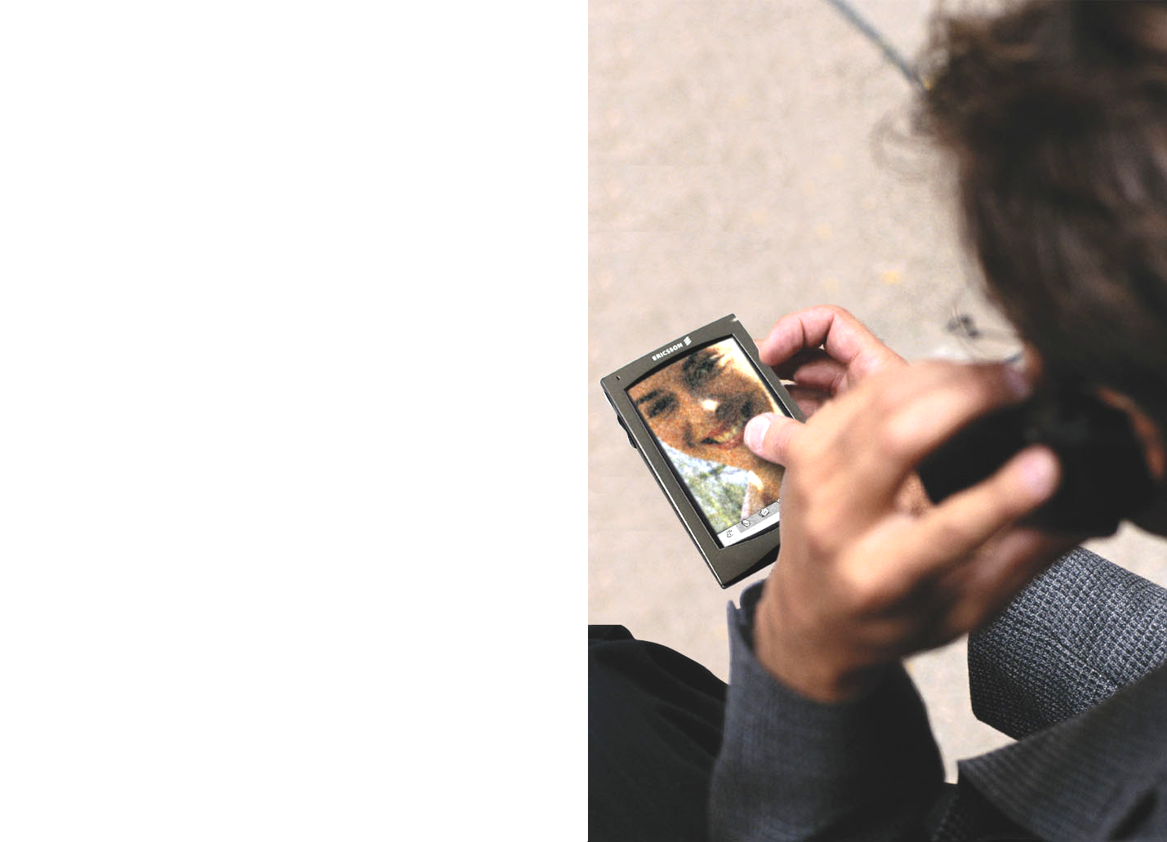
UMTS services
3G
CELL
Videoconference
Video streaming
Video on demand

Slide 59
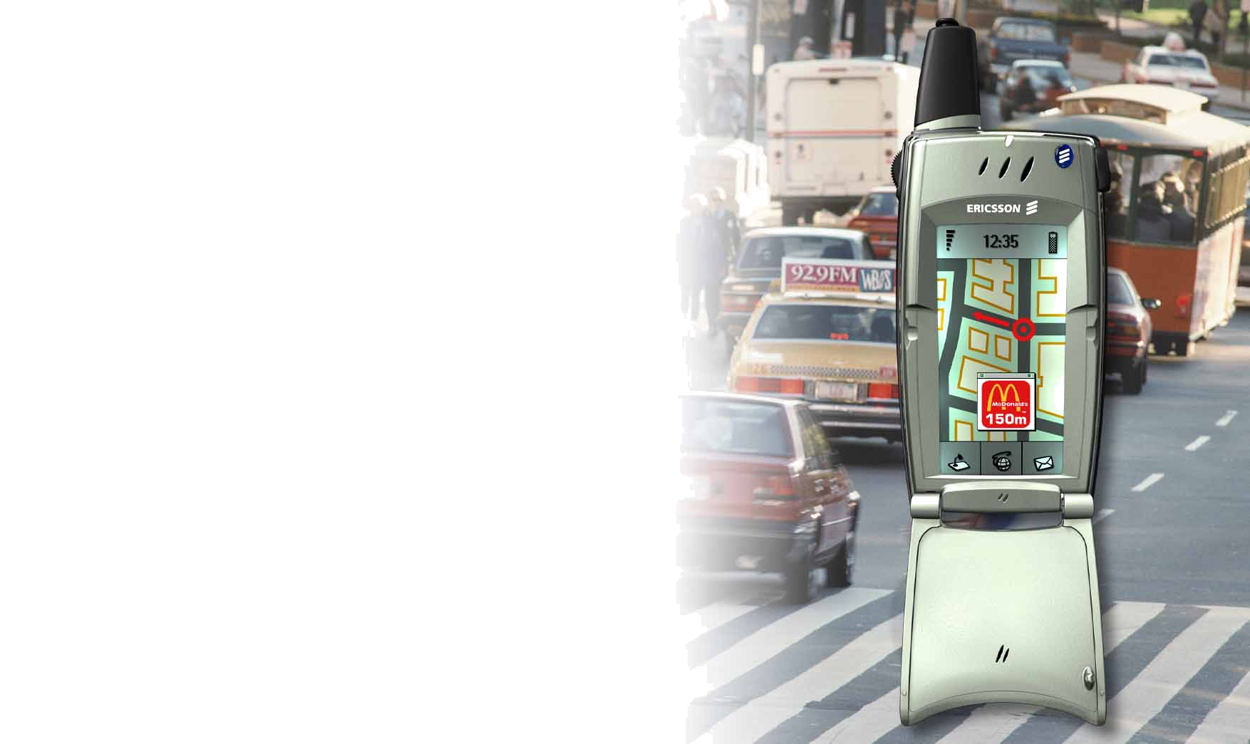
UMTS services
3G
Interactive Map
Localization Service
Navigation System
…
CELL

Slide 60
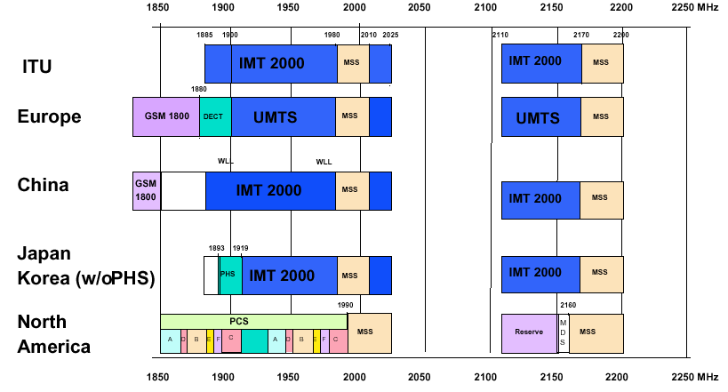
UMTS frequency map
3G
CELL

